Slide 1
Covid -19 detail summary ( Cases , Deaths , Recovered )
File created on: 1/7/2023 2:22:39 PM

Slide 2
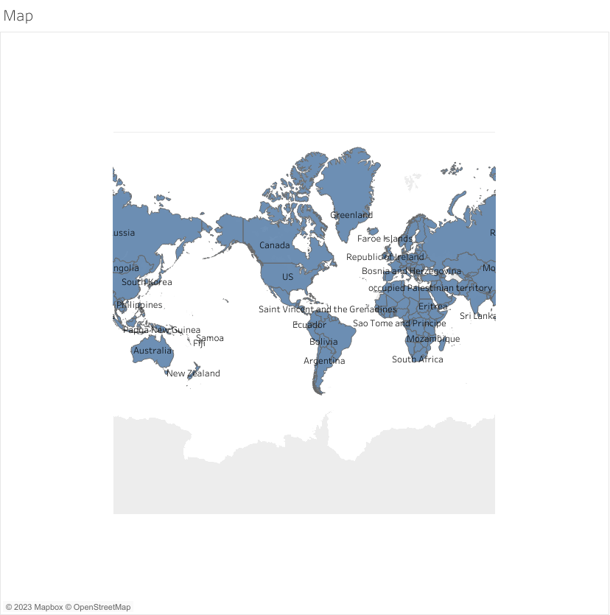

Slide 3
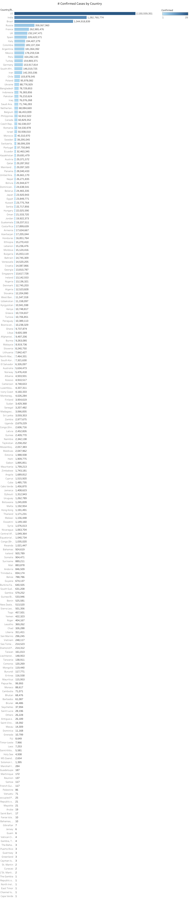

Slide 4
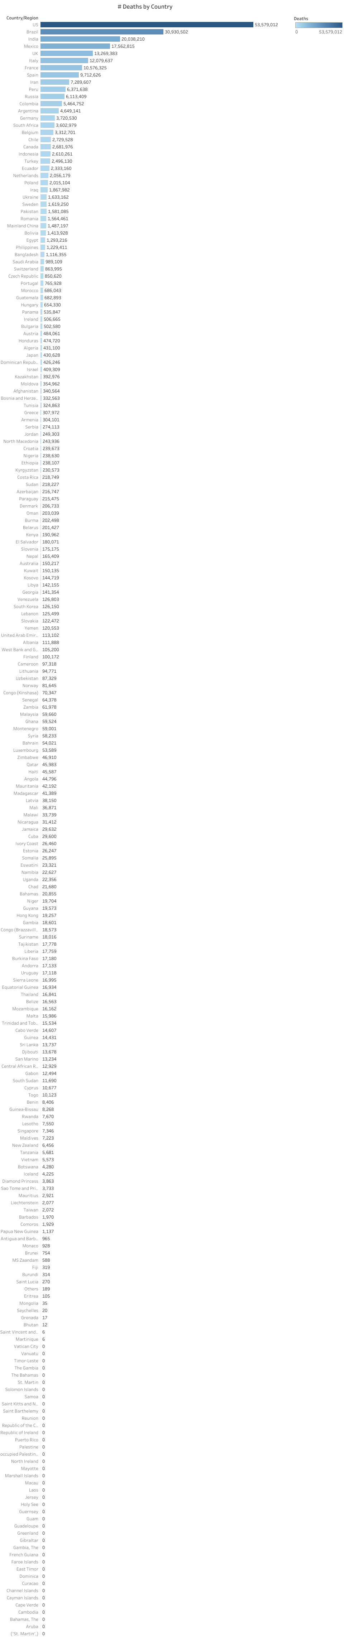

Slide 5
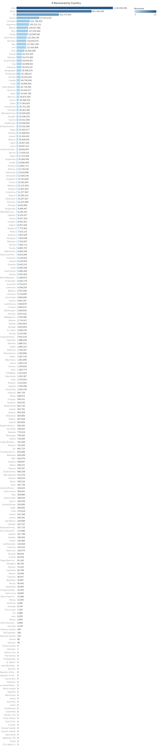

Slide 6
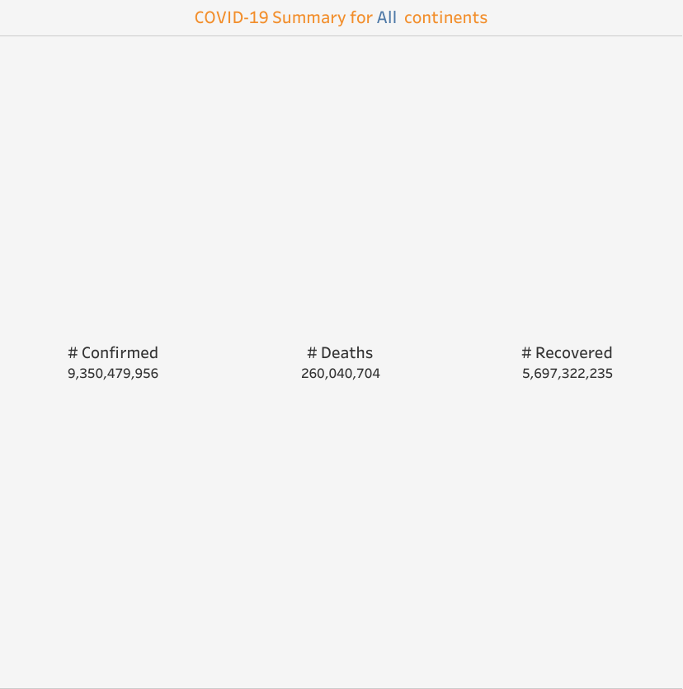

Slide 7


Slide 8
